Slide 1

Lost & Found Application
Presented By:
T K S Sathvik
Navya Sri
Vinay Karthik
Vyshnavi
Mounika
Under The Guidance of
Suramya Biswas

Slide 2

Identifying the Campus Lost Item Problem
In a busy college environment, students often misplace items like ID cards, books, or gadgets. Without a proper system, these items are hard to recover.
Our Lost and Found Management System provides a secure and centralized platform where users can easily report lost or found items.
It helps save time, improves communication, and builds a more responsible and connected campus community.

Slide 3
Proposed Solution
A web application that connects students who have lost or found items.
Centralized data management with verified users and secure communication.
Smart keyword-based matching for quicker identification and recovery.

Slide 4



Our Mission and Goals
Security Digital platform
Quick Connection
Transparency and Safety
To create a secure digital platform that simplifies lost & found item management.
Enable quick connection between users through automated item matching.
Enhance transparency and campus safety through verified listings and admin moderation.

Slide 5







Technology stack
React.js
MySQL 8
Spring Security
Technology
Stack
VS Code
IDE
Java Spring boot 3
Eclipse IDE
Spring Data JPA

Slide 6
System Architecture
Database(SQL)
Persistence via Spring Data JPA
User
End user interacting with UI
System Architecture
Flow
Backend(spring boot)
REST APIs handling logic
Frontend(react)
React-based dynamic UI

Slide 7
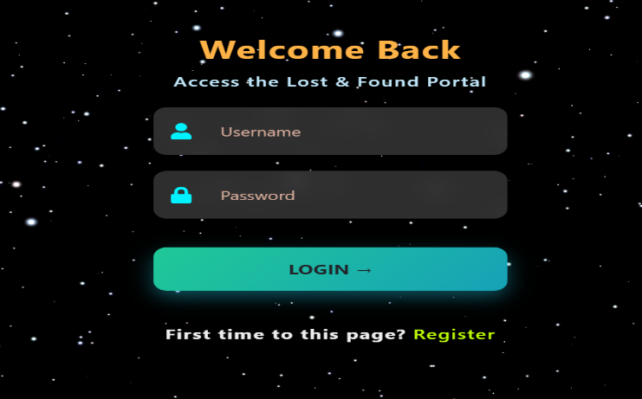
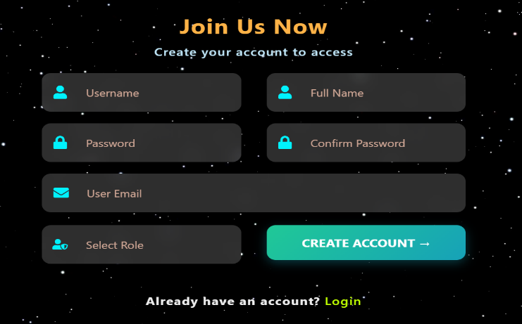
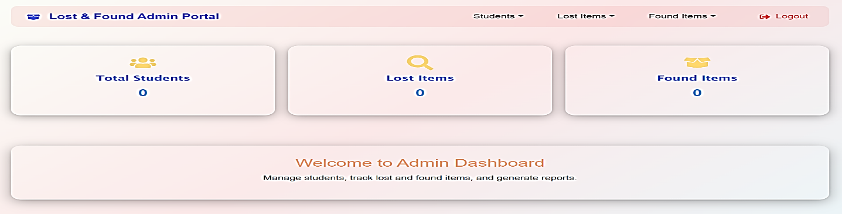
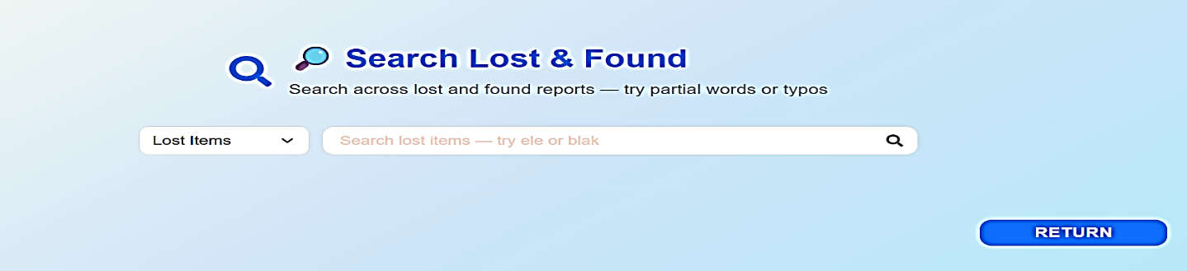
Implementation SnapShots
Responsive User Interface
Built with React to ensure a seamless and intuitive experience for all users across various devices.
Secure RESTful APIs
Developed using Spring Boot, providing a robust and secure backend for reliable data exchange
Integrated MySQL Database
Efficient CRUD operations are fully integrated with a reliable MySQL database for data management.

Slide 8
Core Modules & Functionalities
Authentication & Role Management
Auto-Matching & Smart Search
Post Lost / Found Items
Admin Dashboard & Analytics
Chat / Contact System
Extras:
Campus-restricted listings
Admin moderation for content quality
Real-time matching engine

Slide 9
User Roles
🧑‍🎓
Student: Can post sand search for lost or found items.
Admin: Verifies and moderates posts for security.
Finder: Helps connect and return found items.
🧑‍💻
🤝

Slide 10





Planned Enhancements & Roadmap
AI-based Search
Email / Notification System
Image Recognition
Semantic keyword matching
For alerts and updates
To identify visuality
Mobile App Integration
Advanced Analytic Dashboard
For better accessibility
For admins

Slide 11
Overcoming Development Challenges
Integrating frontend & backend
Used REST APIs and CORS configuration
Data consistency
Implemented JPA Repository with proper constraints
Matching lost/found items efficiently
Developed keyword-based matching algorithm

Slide 12

Conclusion & Learnings
Scalable Application
Full-Stack Development
Successfully developed a scalable full-stack web application.
Improved understanding of full-stack development lifecycle.
Teamwork & Skills
Strengthened teamwork, version control, and deployment skills.
Acknowledgment: We sincerely thank our mentor Suramya Biswas and for his continuous guidance and support.

Slide 13
Thank you

